Slide 1
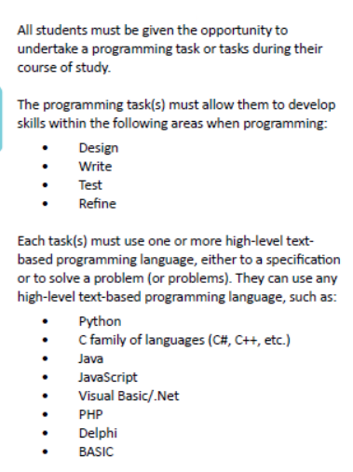
Extra programming content
This part of the spec will contribute directly to Paper 2, and especially to Section B which will be 30 marks of pure programming/design/testing content.
In year 10, you will be given a complex programming scenario and you will have to produce the solution / documentation for it evidencing the sections shown.

Slide 2
Steps for all tasks
For each task in the following slides do this:
Go to your personal OneDrive
Create / use your PPT : ProgEvidence_Surname_First
Create a New slide
Snip in the actual task you are doing
Create New slide: Design
Call it Design
Write the algorithm(flowchart or ERL syntax) for the task
Create New slide: Development and Testing
Call it Development and Testing.
Do some of the task code in Geany / Trinket etc.
Snip your first few lines of code (not complete program)+ show output (this is called Testing)
SHOW errors
Write short text explaining your code / errors / successes etc.
Then create another slide for:
Next round of code + output
Show improvements in code etc. Write short text explaining your code / errors / successes etc.
Repeat all steps in 5 until task is completed. Use any number of slides—more the merrier!
Create New slide: Evaluation
Write about the following (copy out these questions and answer them):
What were you trying to achieve in the task?
How much did you achieve (show all good points)? Show relevant screenshots of testing as proof
What further improvements can you do to your code (examples below)
not enough comments?
not enough validation? Program clashes if…?
Not user friendly?
code not fully complete (mention which requirements not complete?)

Slide 3
Programming evidence tasks

Slide 4
Task 4: Caesar cipher!
Julius Caesar protected his confidential information by encrypting it using a cipher. Caesar's cipher shifts each letter by a number of letters. If the shift takes you past the end of the alphabet, just rotate back to the front of the alphabet. In the case of a rotation by 3, w, x, y and z would map to z, a, b and c.
Original alphabet: abcdefghijklmnopqrstuvwxyz
Alphabet rotated +3: defghijklmnopqrstuvwxyzabc
Your program must include:
Evidence of modular programming (functions/procedures)
Fully commented code
Appropriate use of arrays
BRONZE - encrypt:
Takes a string (the plaintext) and an integer from 1-25 (the shift) and returns the encrypted string
SILVER – encrypt and decrypt:
As above, but program should ask the user if they want to encrypt or decrypt. The encrypt subroutine must complete the encrypt task above. The decrypt subroutine must take ciphertext and the key as input and output the plaintext. Bonus – use while loop to keep asking the user if they want to go again until they say no.
GOLD – Output all possibilities:
Adapt the silver task so that the decrypt subroutine only takes cipher text as input. Your program must print out every possible plaintext, one for each shift, to the user.
PLATINUM – A different cipher too

